Slide 1
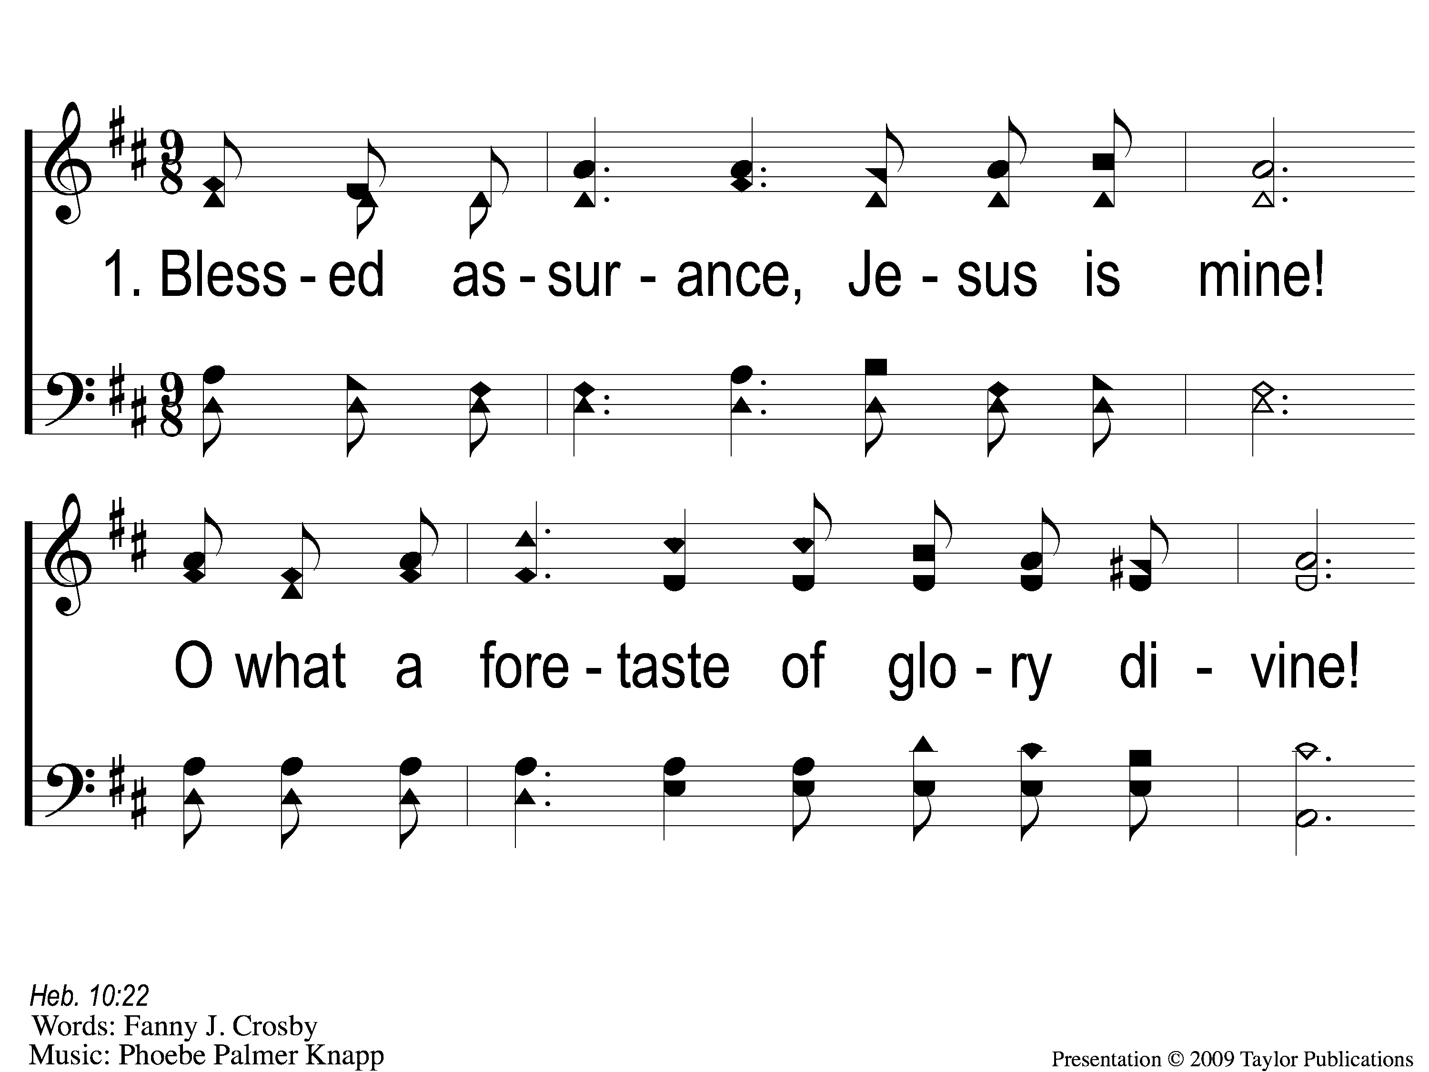
1-1 Blessed Assurance
Blessed Assurance
43

Slide 2
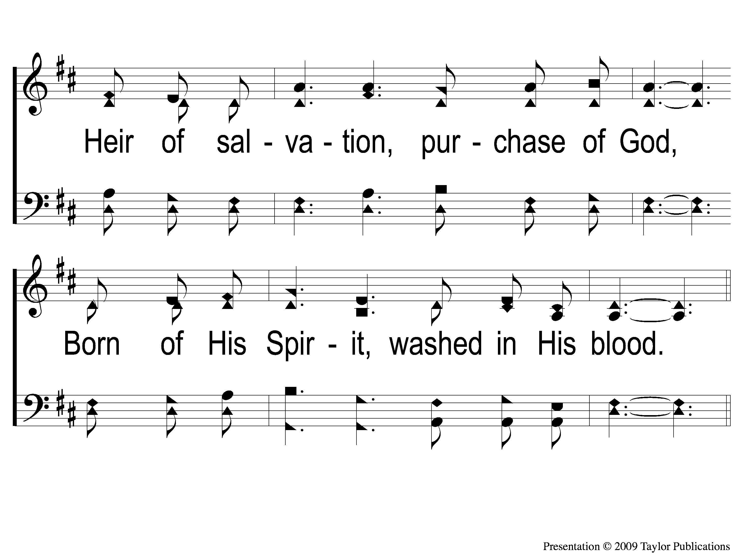
1-2 Blessed Assurance
Blessed Assurance
43

Slide 3
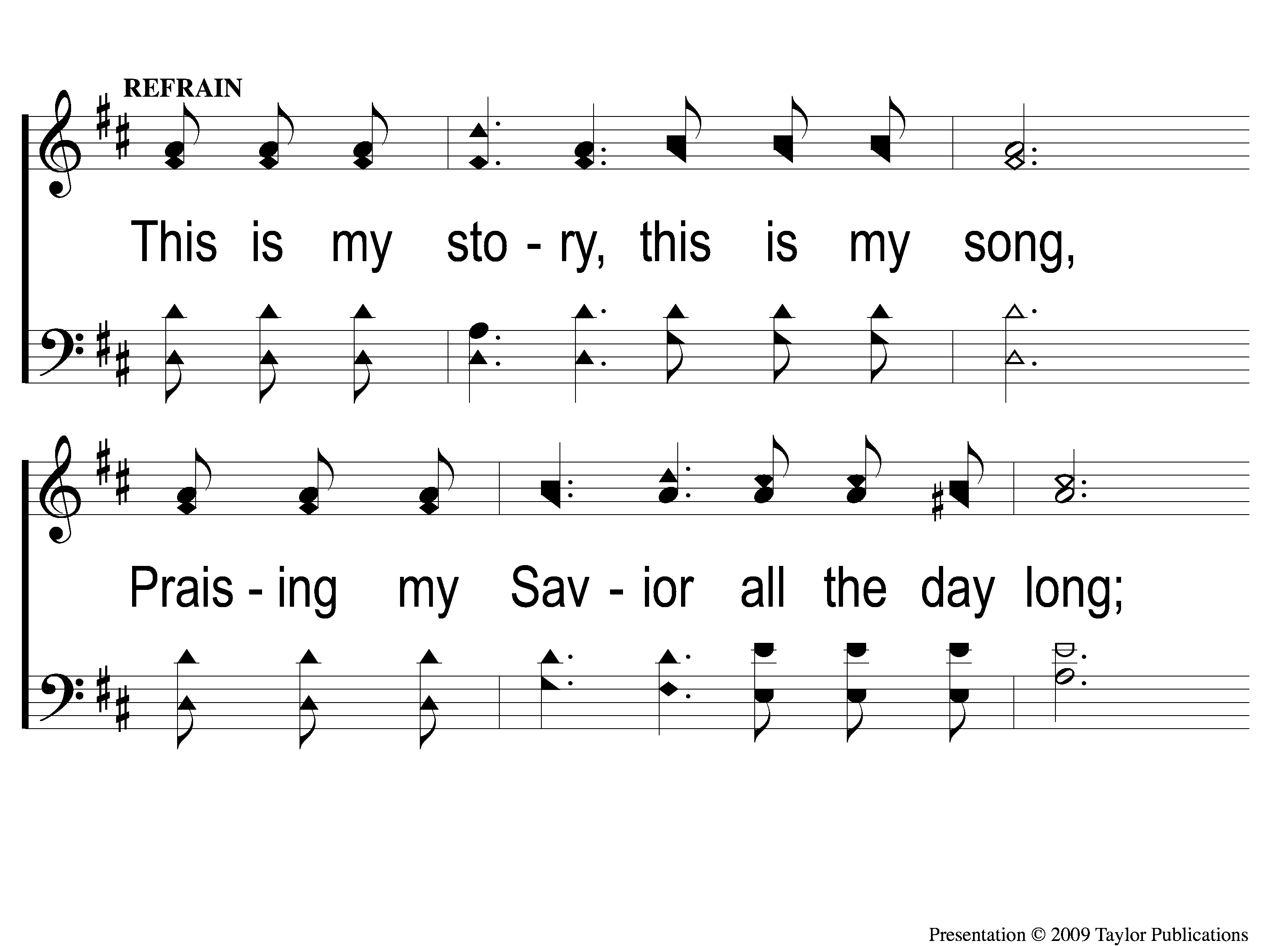
C-1 Blessed Assurance
Blessed Assurance
43

Slide 4
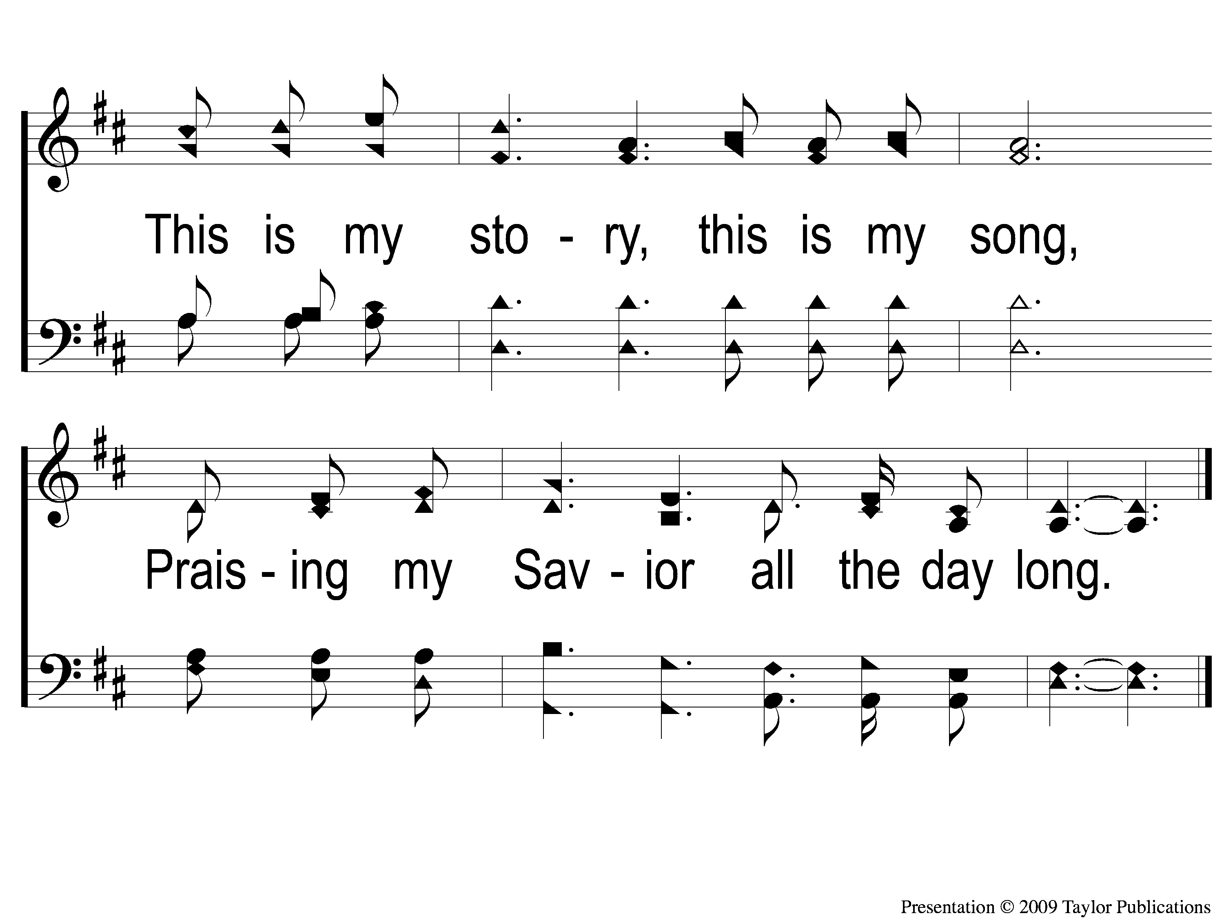
C-2 Blessed Assurance
Blessed Assurance
43

Slide 5
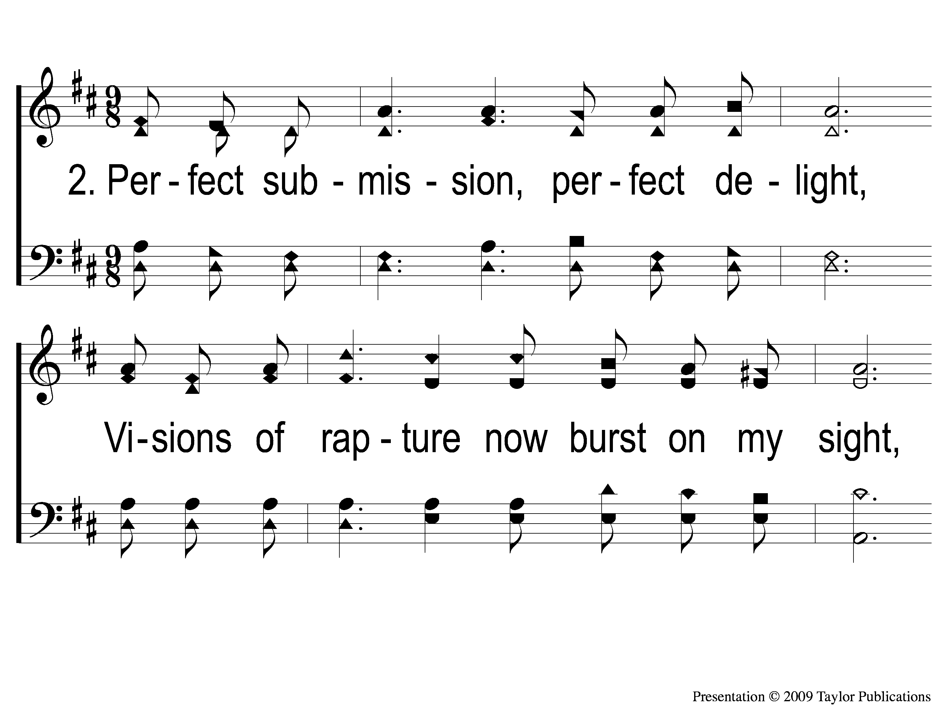
2-1 Blessed Assurance
Blessed Assurance
43

Slide 6
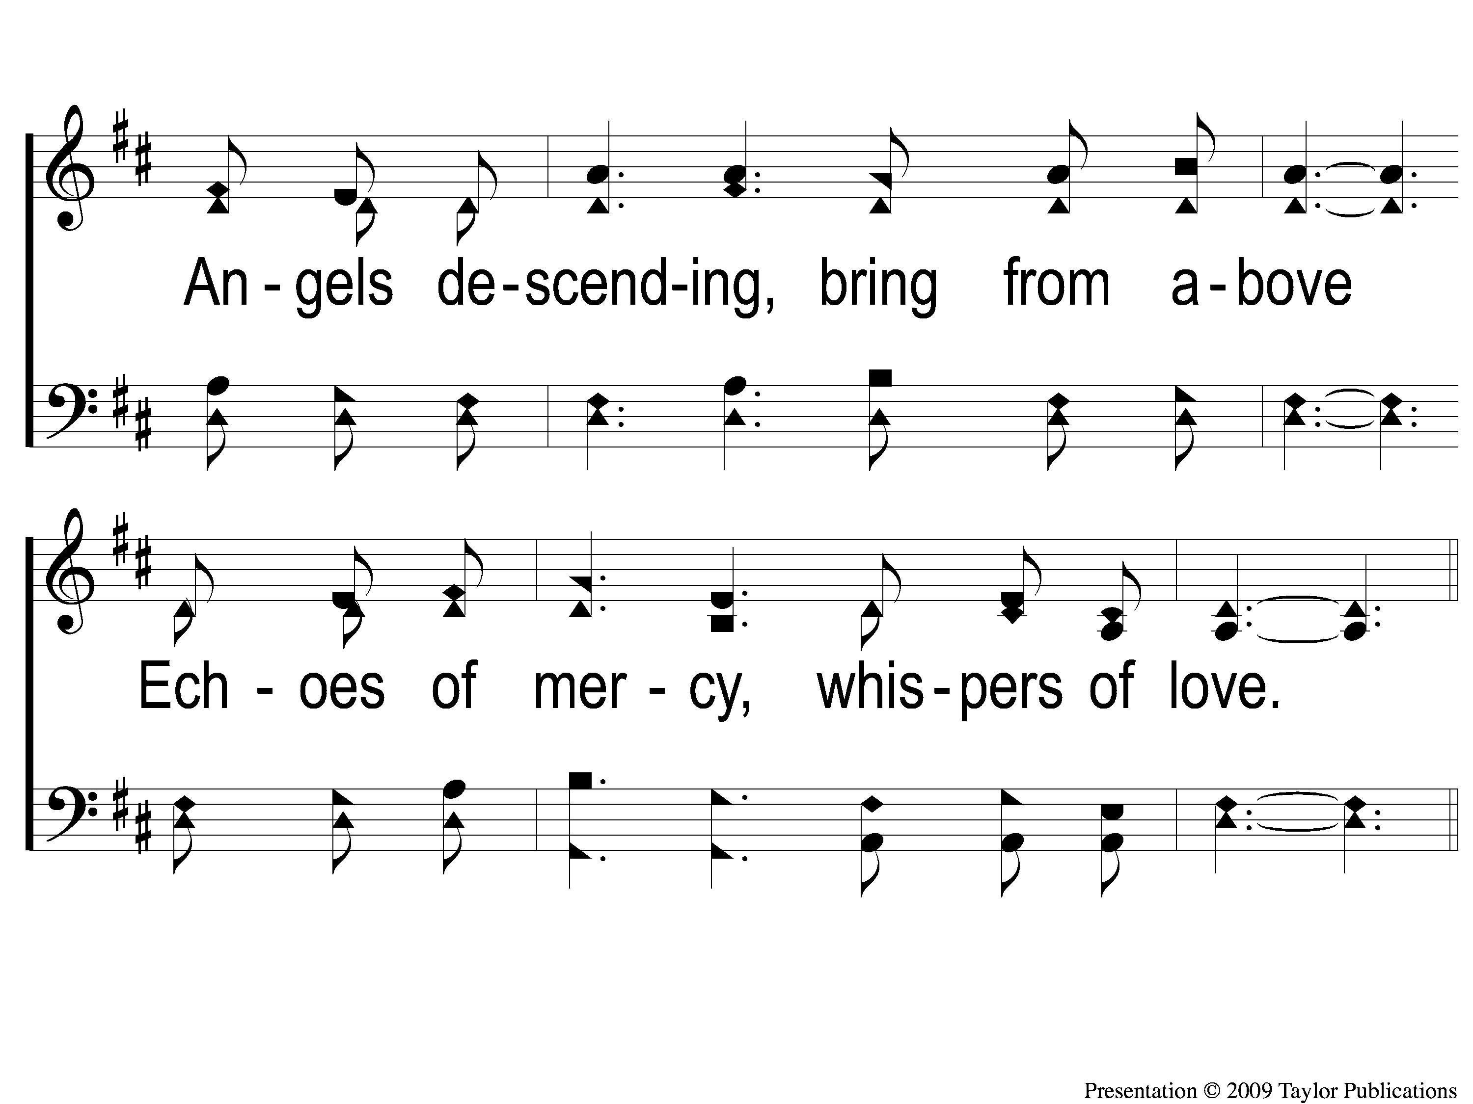
2-2 Blessed Assurance
Blessed Assurance
43

Slide 7
C-1 Blessed Assurance
Blessed Assurance
43

Slide 8
C-2 Blessed Assurance
Blessed Assurance
43

Slide 9
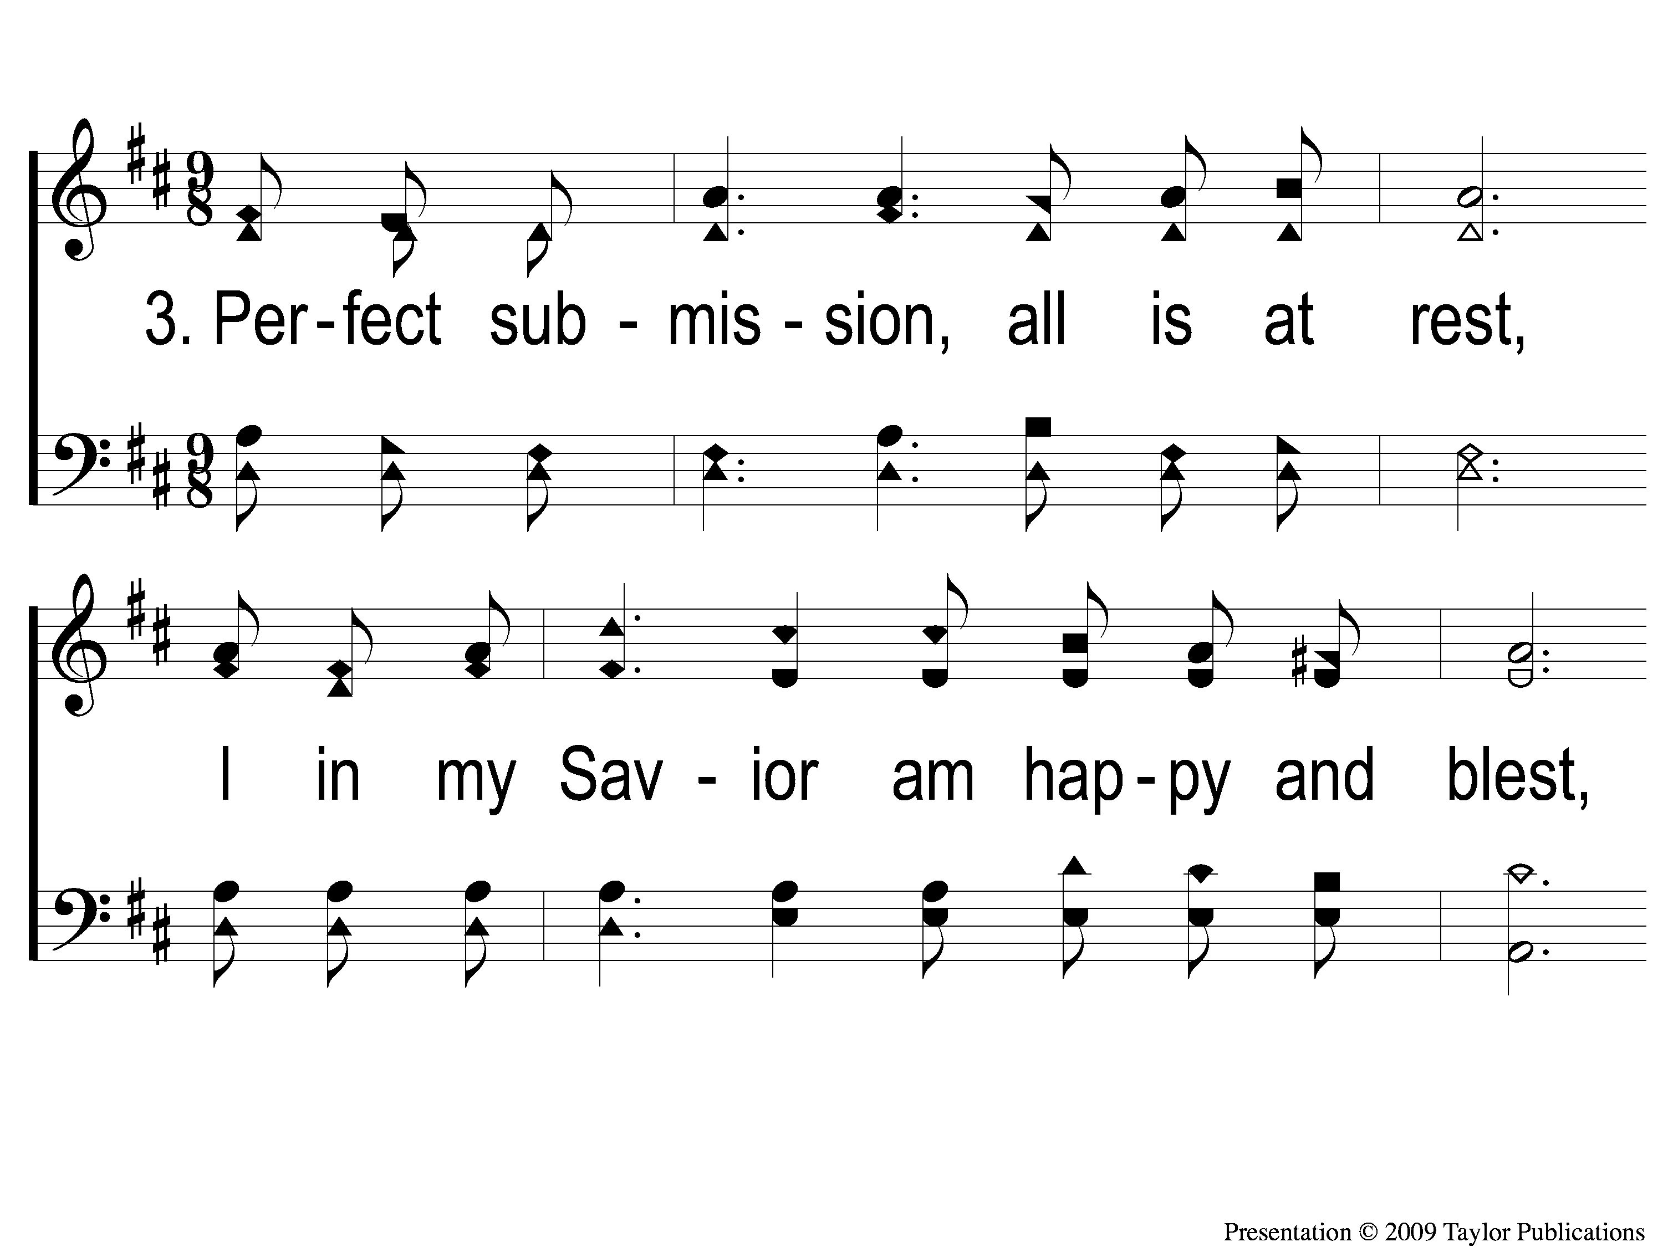
3-1 Blessed Assurance
Blessed Assurance
43

Slide 10
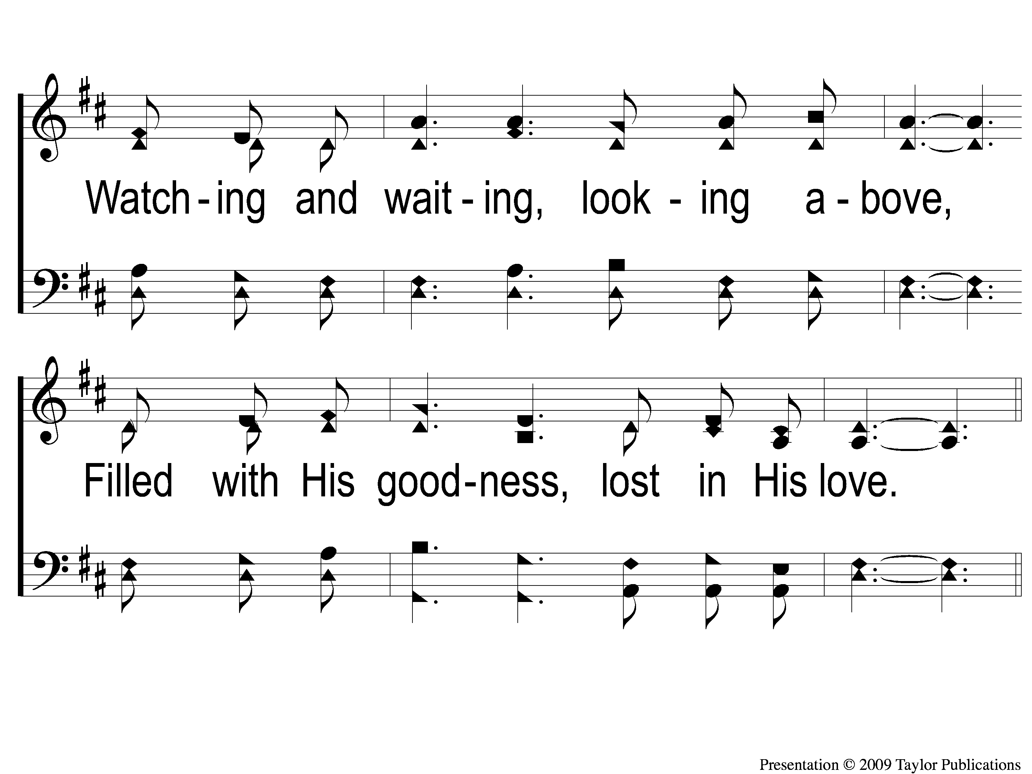
3-2 Blessed Assurance
Blessed Assurance
43

Slide 11
C-1 Blessed Assurance
Blessed Assurance
43

Slide 12
C-2 Blessed Assurance
Blessed Assurance
43

